Slide 1
RNS Institute of Technology Department of Information Science and Engineering
DESIGN AND ANALYSIS OF ALGORITHMS LABORATORY
(18CSL47)
Shortest Distance
Staff in Charge: Mrs. Kusuma S Carried out by
Designation: Assistant Professor
ROHITH KUMAR HK (1RN19IS122)
RUSWANTH K (1RN19IS123)
RUTVICK SREEDHAR (1RN19IS124)

Slide 2
CONTENTS
Abstract
Introduction
Objective
Algorithm Design Technique
Project Architecture
Implementation
Results
Applications
Conclusion & Future Enhancements
Reference

Slide 3
ABSTRACT
Shortest path problems are fundamental network optimization. Lee's algorithm is a path finding algorithm and one possible solution for maze routing, which is often used in computer-aided design systems to route wires on printed circuit boards .
The scope of this chapter is to provide an extensive treatment of shortest path algorithms covering both classical and recently proposed approaches.
Roads play a major role to the people live in various state cities, town and villages. Each and every day they travel to work to schools, business meetings and to transport their goods. These type of programs helps to find the shortest distance among the surroundings we have.

Slide 4
INTRODUCTION
The Maze Routing algorithm is an algorithm to find connections between the terminals and the Lee algorithm is one possible solution for Maze routing problems.
Lee algorithm searches for the shortest path between two terminals and guarantees to find a route between two points if the connection exists. This algorithm also guarantees the shortest path between the source and the destination terminals.

Slide 5
OBJECTIVES
The circuit boards have lot of wirings to be done. So we aim to achieve to get optimal solution of routing for the wires by understanding this shortest distance algorithms.
In a large scale analysis, shortest path problem are inevitable in road network applications such as city emergency handling and drive guiding system, where the optimal routings have to be found. To quickly find the solution the efficiency of the algorithm is very important.
There are situations where routing has to be done from one point to another and then to another point and so on. So by understanding the shortest algorithms like Lee algorithm we would like to create programs where multiple locations can be entered and best solution of routing between them will be calculated.

Slide 6
ALLGORITHM DESIGN TECHNIQUE
LEE ALGORITHM: The Lee algorithm is one possible solution for maze routing problems based on breadth-first search. It always gives an optimal solution, if one exists, but is slow and requires considerable memory.
Algorithm:
1) Initialization:
Select start point, mark with 0
i := 0
2) Wave expansion
REPEAT
- Mark all unlabeled neighbors of points marked with i with i+1
- i := i+1
UNTIL ((target reached) or (no points can be marked))

Slide 7
3) Backtrace
- go to the target point
REPEAT
- go to next node that has a lower mark than the current node
- add this node to path
UNTIL (start point reached)
4) Clearance
- Block the path for future wirings
- Delete all marks

Slide 8
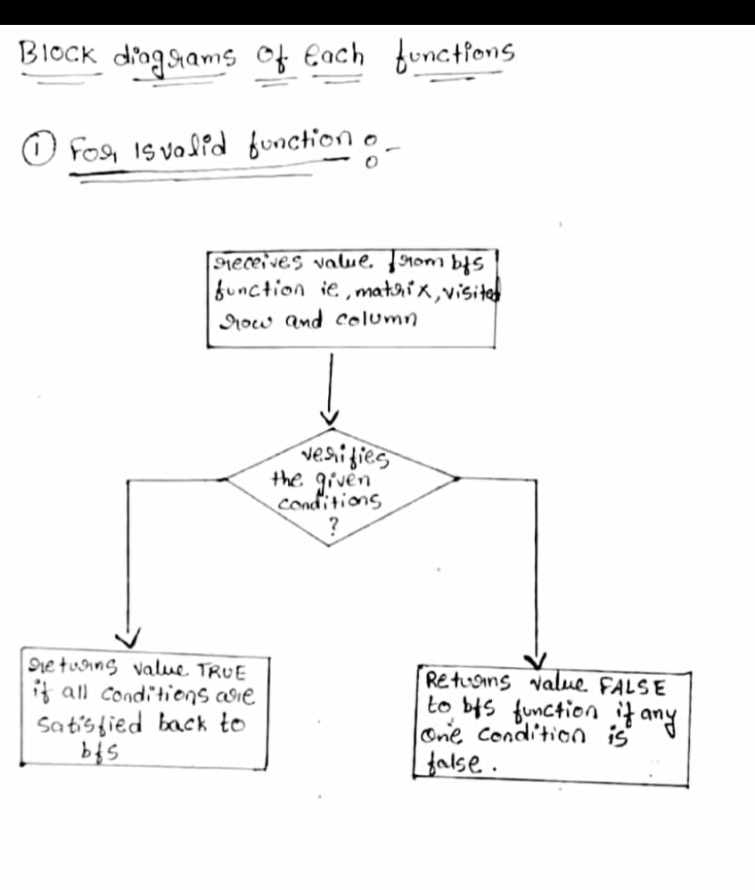
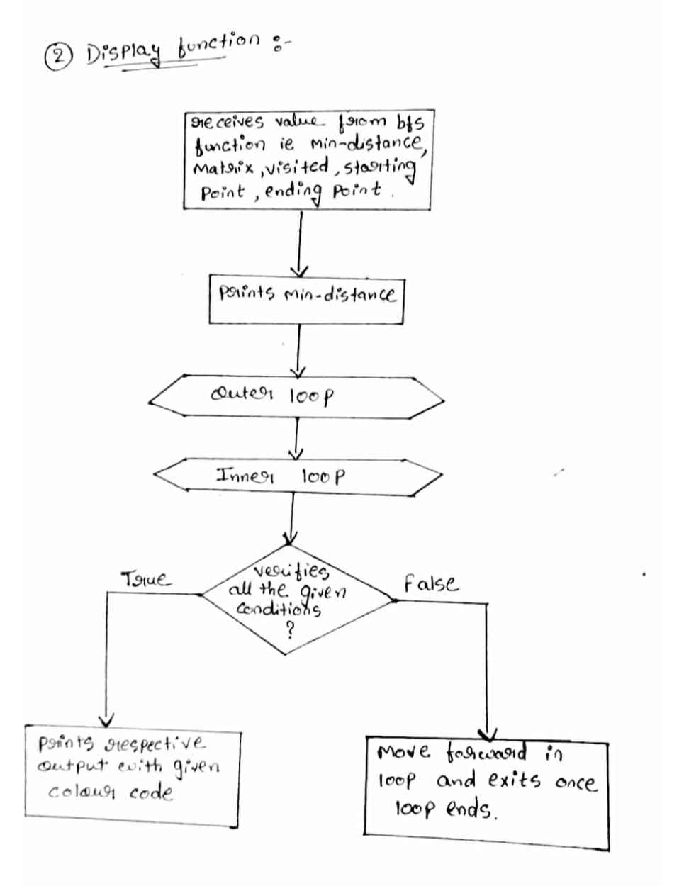
PROJECT ARCHITECTURE

Slide 9
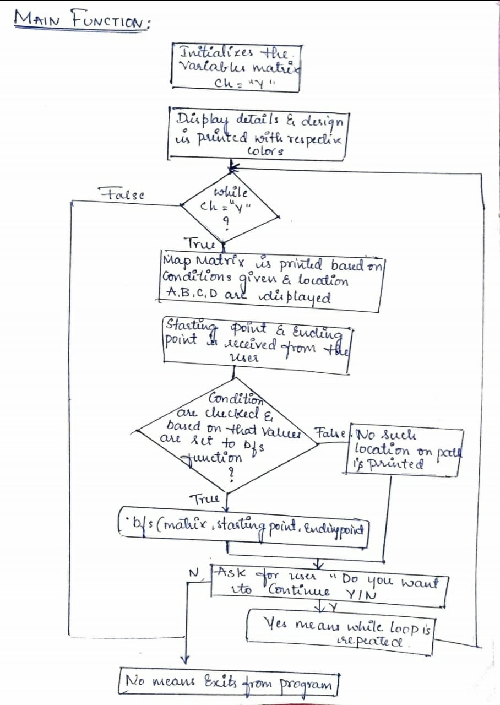
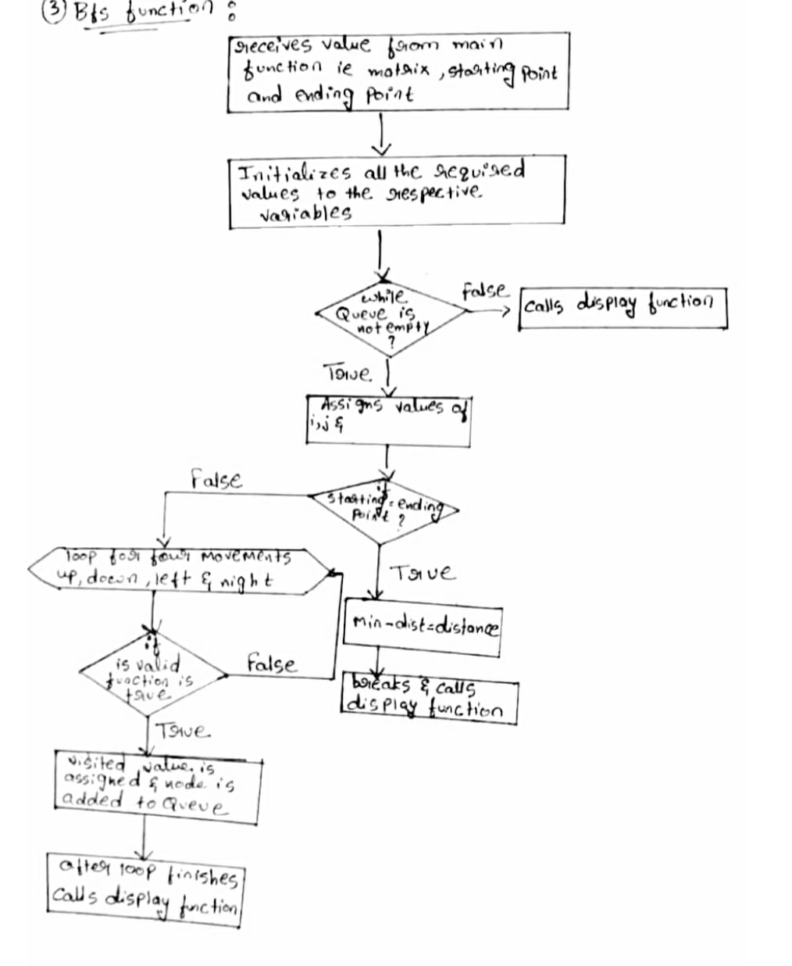

Slide 10
IMPLEMENTATION MODULES
Node class
variables
>x
>y
>distance
Enum class color
step1: regular font colors
>black
>red
>green
>yellow
>blue
>magenta
>cyan
>white

Slide 11
Class lee
variables
>m(row)
>n(columns)
>matrix(12*12)
Function in class lee
1) isvalid (mat[][], visited[][], row, col)
>step1: return true if row >= 0&&row<M&&col>=0&&visited[row][col]!=1
otherwise return false.
2) display (M[][], v[][], mid, i, j, x, y,)
>step1: for r=0 to12
>step2: for s=0 to 12
if v[r][s]==1
m[r][s]==8
end of inner loop
>step3: if mid= max_value
print(destination can’t be reached)

Slide 12
Else
print(shortest path mid)
>step4: for r=0 to 12
for s=0 to 12
if r=I & s=j
print m[r][s] is green color
else
print m[r][s] is red color
else
print path in yellow color
else
print m[r][s]
end of if else
end of inner loop
end of outer loop
>step5: for r=0 to 12
for s=0 to 12
if v[r][s]=1
m[r][s]=1

Slide 13
end if
end inner loop
end outer loop
>Step6: return
3) bfs(matrix[][], i, j, x, y)
>step1: row[]={-1, 0, 0, 1}
col[]={0, -1,1, 0}
step1← i
step2← j
visited[i][j]=1
>step2: add node to queue
>step3: min_dist= MAX_VALUE
>step4: while queue is no empty
i = node.x
j = node.y
dist = node.distance
>step5: if i=x & j=y
min_dist=dist

Slide 14
break;
end if.
>step6: for k=0 to 4
>step7: if(is valid () = true)
visited[it row[k][j+col[k]]=1
add this node to queue
end if
end for
end while
>step8: call display (matrix, visited, min _ dist, st1, st2, x, y)
>step9: return
4) main()
>step1: print all display details with respective design and colors.
>step2: while ch= “4”
>step3: for i=0 to 12
>step4: for j=0 to 12
print the location and matrix map with respective design and colors
end inner loop
end outer loop

Slide 15
>step5: accept values of starting and ending locations.
>step6: call bfs(matrix, starting points, ending points) based on the conditions of
locations
else print no such path or location.
>step7: print “do you want to continue y/n”
>step8: input value of ch from user
end of while loop
>step9: print “exited from maps”
>Step10: stop.

Slide 16
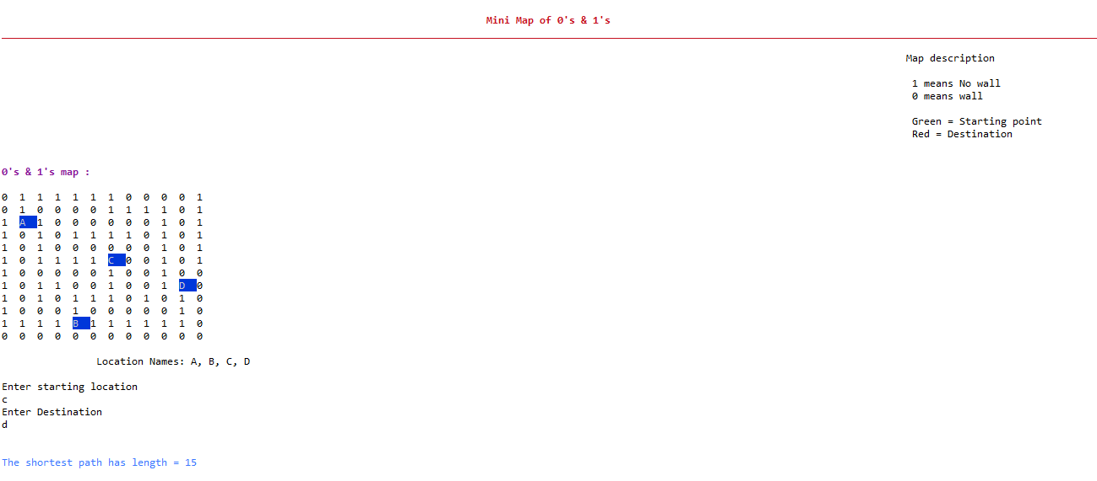
RESULTS

Slide 17
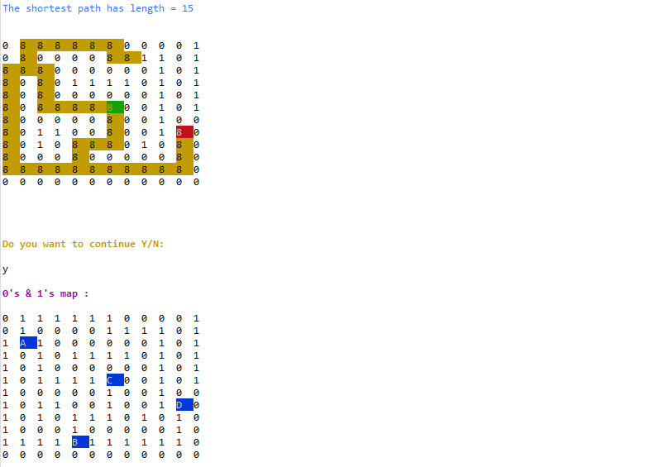

Slide 18
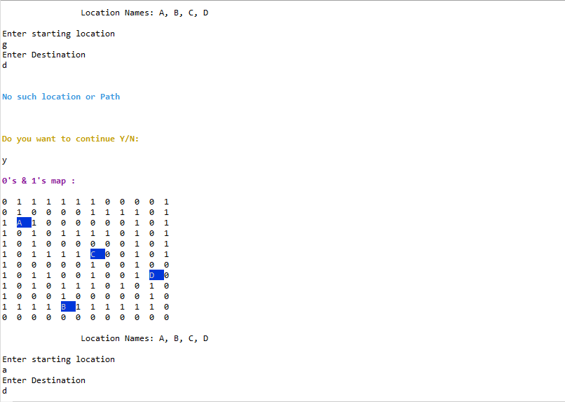

Slide 19
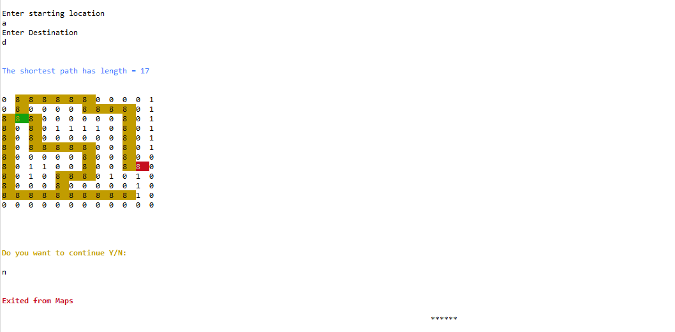

Slide 20
Lee algorithm
Dijkstra’s algorithm
Lee algorithm uses BFS method to find shortest distance for maze routing. | In this method it uses graphs and edge weights to find shortest distance between nodes.
Lee algorithm uses more memory and takes more time. | This algorithm is more efficient since the edge weights are given and uses less time.
It uses simple queue. | It uses priority queue.
Time complexity is O(M*N). | Time complexity is O(V+Elog(V)).

Slide 21
APPLICATIONS
Robotic Path. Nowadays drones and robots have come into existence.
VLSI routing
Computer Aided Design (CAD)
Global and detailed routing

Slide 22
CONCLUSION & FUTURE ENHANCMENTS
We would like to conclude that by understanding the logic of the algorithms such as lee algorithm which uses BFS method to find shortest distance , we can understand how big software such as Google maps works.
By this knowledge we can find much more optimal solutions for routing purposes in any manner i.e. wiring in PCBs , global routing or even for local area offline road maps for emergency purposes.
In future, since lee algorithm occupies more memory, we can upgrade to A* algorithm or even more better algorithms to find shortest distance.
We would like to find much better algorithm in which multiple points or locations can be given and optimal solution for routing can be found where all those locations are visited once.

Slide 23
REFERENCES
https://atechdaily.com/posts/Lee-Algorithm-in-Java
https://youtu.be/IzYCYXfVTF8
https://stackoverflow.com/questions/5762491

